Slide 1
Lexical Analyzer: Key Concepts and Techniques
Ziyad Amjad
FA21-BCS-057

Slide 2
Introduction
A lexical analyzer, or lexer, processes the input source code to produce a sequence of tokens.
These tokens represent logical entities such as keywords, operators, variables, constants, and special symbols.

Slide 3
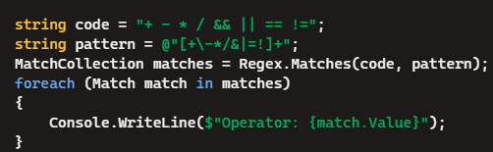
Recognition of Operators
Operators:
Types: Arithmetic, Logical, Relational, etc.
Example Code in C#:

Slide 4
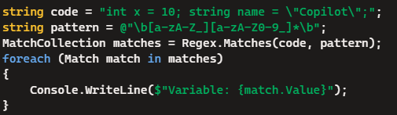
Recognition of Variables
Variables:
Identifiers follow specific naming rules in C#.
Example Code in C#:

Slide 5
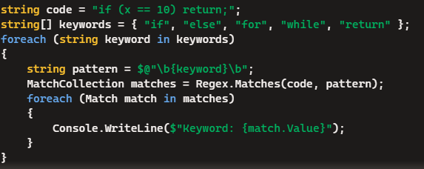
Recognition of Keywords
Keywords:
Reserved words in C# programming.
Example Code in C#:

Slide 6
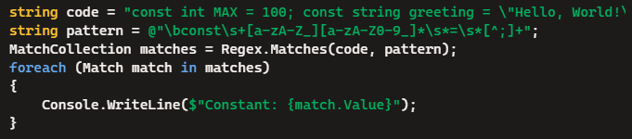
Recognition of Constants
Constants:
Numerical and string literals.
Example Code in C#:

Slide 7
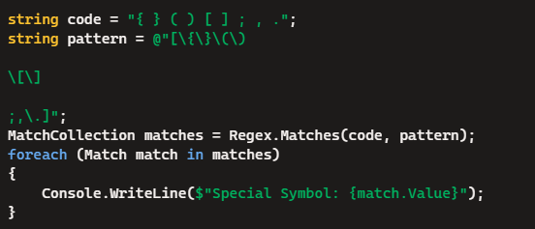
Recognition of Special Symbols
Special Symbols:
Punctuation, brackets, etc.
Example Code in C#:

Slide 8
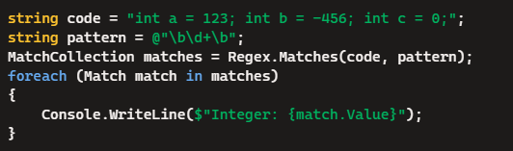
Recognition of Integers
Integers:
Whole numbers, positive or negative.
Example Code in C#:

